Slide 1
TOPIC:
INCOME TAX AND HEADS OF INCOME
SUBMITTED BY: SUBMITTED TO:
SANIYA USMANI SHASHWAT SINGHAL

Slide 2
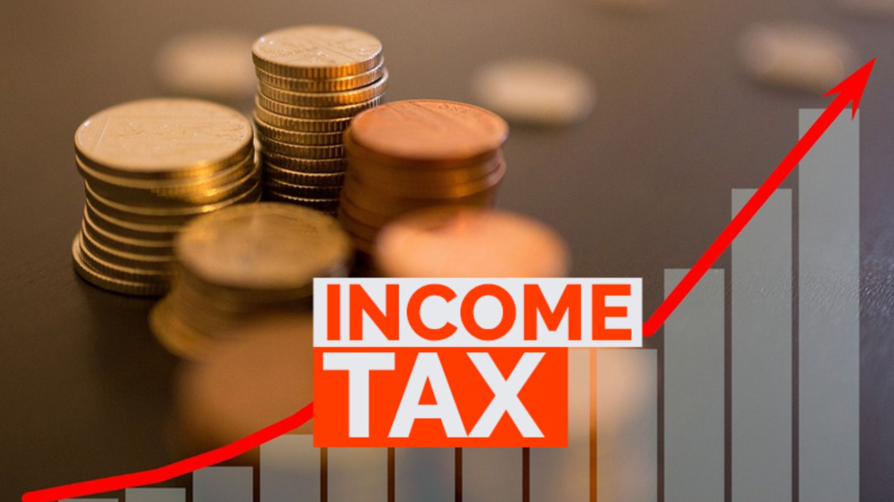
Introduction
Income tax is a direct tax levied by the government on the income earned by individuals, businesses, and other entities.
It is one of the government's major sources of revenue.
The tax collected is used to provide public services and promote economic development.

Slide 3
Background of Income Tax
Income tax was introduced to generate revenue for government expenditure.
In India, income tax was first introduced in 1860 by Sir James Wilson during British rule.
Today, income tax is governed by the Income-tax Act, 1961.
The tax system is administered by the Central Board of Direct Taxes (CBDT) under the Income Tax Department.

Slide 4
Why Do We Pay Income Tax?
Income tax is important because it helps the government:
Build roads, bridges, and highways.
Improve healthcare facilities and hospitals.
Support schools, colleges, and education.
Strengthen national defense and security.
Provide welfare schemes and subsidies.
Promote economic growth and development.
Income tax is the contribution citizens make toward the country's development.

Slide 5
Objectives of Income Tax
Generate revenue for the government.
Reduce income inequality.
Finance public welfare programs.
Encourage savings and investments through tax benefits.
Promote balanced economic development.

Slide 6
What is Income?
Income refers to money or benefits earned by a person or organization from different sources during a financial year.
Examples:
Salary
Rent
Business profit
Interest
Capital gains
Dividends

Slide 7
Heads of Income
Heads of Income
According to the Income-tax Act, 1961, taxable income is classified into five heads:
Income from Salary
Income from House Property
Profits and Gains from Business or Profession
Capital Gains
Income from Other Sources

Slide 8

Income from Salary
Includes income received by an employee from an employer:
Basic salary
Dearness allowance
House Rent Allowance (HRA)
Bonus
Commission
Pension
Perquisites
Example: A teacher receiving a monthly salary.

Slide 9

Income from House Property
Income earned from owning and renting out a property.
Examples:
Rent from a residential house
Rent from a commercial building

Slide 10

Profits and Gains from Business or Profession
Income earned from:
Business
Trade
Manufacturing
Professional services
Examples:
Shop owner
Doctor
Lawyer
Chartered Accountant
Freelancer

Slide 11
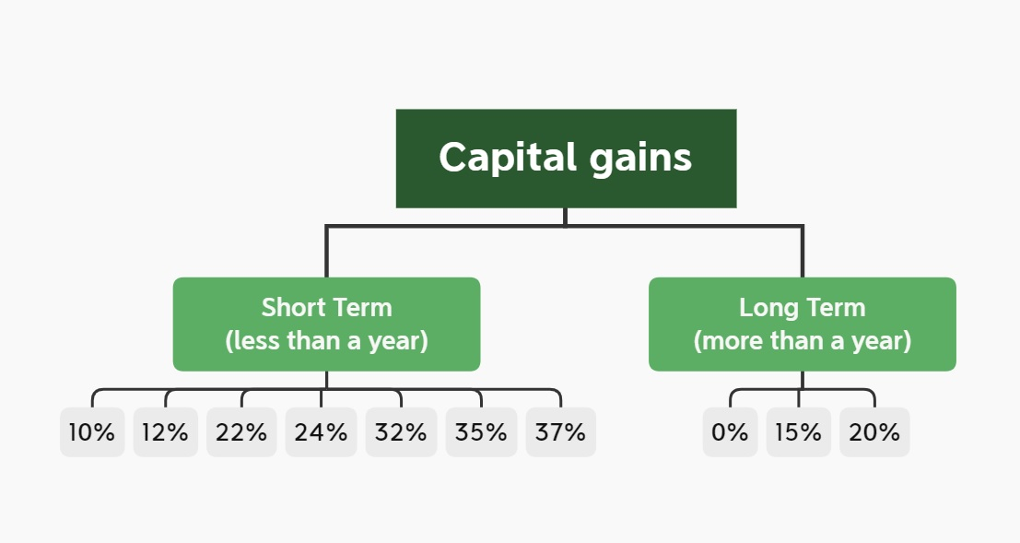
Capital Gains
Profit earned from selling capital assets such as:
Land
Building
Shares
Gold
Mutual funds
Types:
Short-Term Capital Gain (STCG)
Long-Term Capital Gain (LTCG)

Slide 12

Income from Other Sources
Income that does not fall under the other four heads.
Examples:
Bank interest
Fixed deposit interest
Dividends
Lottery winnings
Gifts (subject to tax rules)
Family pension

Slide 13
Importance of Classifying Income
Ensures accurate tax calculation.
Helps taxpayers claim eligible deductions and exemptions.
Simplifies filing of income tax returns.
Ensures compliance with tax laws.

Slide 14
FORMAT FOR COMPUTATION OF INCOME TAX
A standard Format for Computation of Income Tax (commonly used for individuals and businesses) is organized as follows:
Income Tax Computation Format (Individual)
Particulars | Amount (₹)
Income from Salary | XXX
Less: Exemptions (if applicable) | (XXX)
Net Salary Income | XXX
Add: Income from House Property | XXX
Add: Profits and Gains from Business/Profession | XXX
Add: Capital Gains | XXX
Add: Income from Other Sources | XXX
Gross Total Income (GTI) | XXX

Slide 15
Less: Deductions under Chapter VI-A (e.g., eligible deductions) | (XXX)
Total Taxable Income | XXX
Income Tax as per applicable tax rates | XXX
Add: Surcharge (if applicable) | XXX
Add: Health & Education Cess | XXX
Gross Tax Liability | XXX
Less: Tax Deducted at Source (TDS) | (XXX)
Less: Advance Tax Paid | (XXX)
Less: Self-Assessment Tax Paid | (XXX)
Net Tax Payable / (Refund Due) | XXX

Slide 16
Notes
Include all five heads of income, as applicable:
  Salary
  House Property
  Business or Profession
  Capital Gains
  Other Sources
Deductions should be claimed only if permitted under the applicable tax regime.
Apply the tax rates relevant to the assessment year and tax regime (old or new).
Add surcharge and Health & Education Cess where applicable.
Deduct taxes already paid (TDS, advance tax, self-assessment tax) to determine the final tax payable or refund.

Slide 17
Conclusion
Income tax is an essential source of government revenue.
It supports public services, infrastructure, and national development.
The five heads of income help classify earnings for proper tax computation.
Paying income tax is both a legal responsibility and a contribution to the nation's progress.

